Slide 1

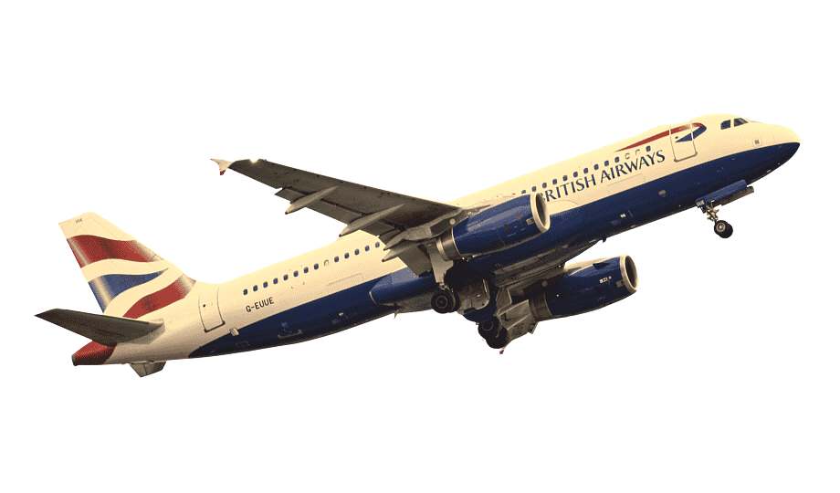
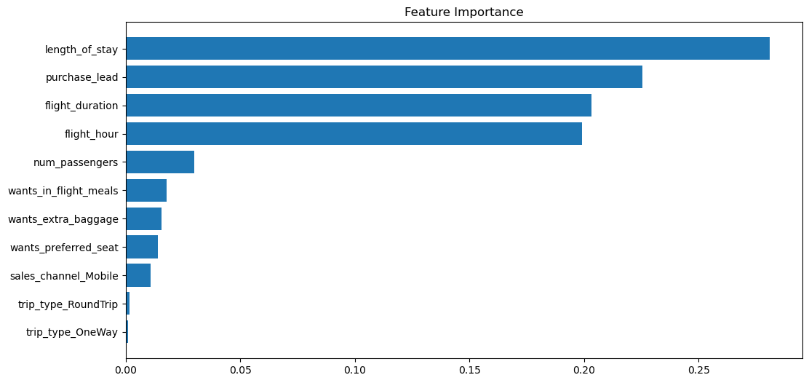
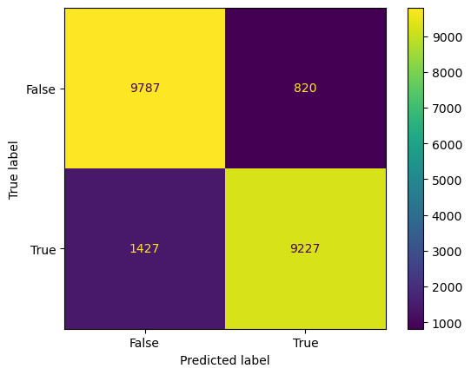
BRITISH AIRWAYS BOOKING PREDICTION MODEL
CONFUSION MATRIX & MODEL EVALUATION METRICS
89
F1 SCORE
FEATURE IMPORTANCE IN THE MODEL
FEW TRENDS APART FROM THE ABOVE FEATURE IMPORTANCE
87
RECALL
Malaysian customers have the best booking ratio followed by Australia.
Auckland to Kuala Lumpur is the most booked route.
Customers prefer early morning and afternoon flights more.
88
92
PRECISION
OVERALL MODEL ACCURACY
(Across 10 Cross Validations)

